Slide 1
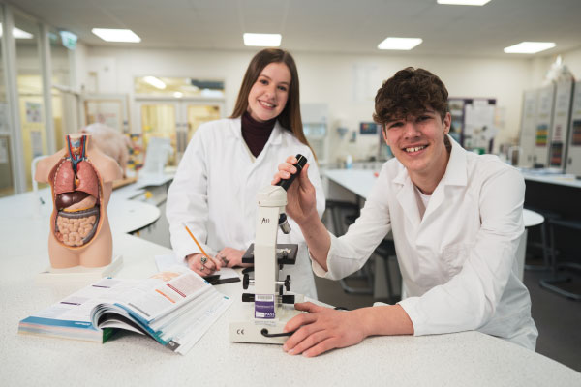
YMCA Level 3 Diploma (Practitioner) Personal Training
What will happen in my first week?
You will meet the rest of the group that you will be studying with over your year at college. The first week will be a very practical based week, in terms of starting studying for the qualification and taking part in training activities (gym based and sports hall/functional training zone circuit training).
What can I look forward to in my first year? The course is an intense one-year course. In the first half of the academic year the Level 2 Fitness Instructor will be studied and achieved. The second half of the year builds on the skills and knowledge developed in the first half of the year by focussing on the Level 3 Diploma in Personal Training.
Do I need to buy any equipment or kit?
You will need practical kit for every day you are in college; a college bundle of kit is available from Macron: https://www.macronstorenw.co.uk. You will need an A4 pad, plenty of pens, a level arch file and a memory stick to store your work.
What will I study in my first term?
Theory and Practical Based Subjects at Level 2: • Anatomy and physiology for exercise and fitness instructors • Providing a positive customer experience in the exercise environment • Lifestyle management and health awareness • Gym-based programme planning and preparation • Gym-based programme delivery and professional instruction
Who will teach me?
Kat Buckley
Are there any books I need to buy or useful websites I should look at?
There are no specific books you need to buy for this course, course booklets are accessible through our learning resource centre for you, and you can access these through Solar once your course has started, if you would like to have a look at the qualification to get a head start you can visit:
ymca-l3-c-gym-instructing-qs.pdf (ymcaawards.co.uk)
YMCA Level 3 Diploma in Personal Training (Practitioner) (603/2438/7) - YMCA Awards
?

