Slide 1
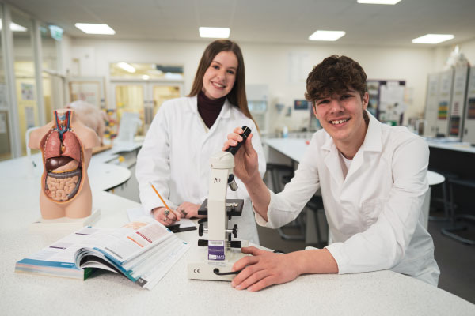
Level 2 First Extended Certificate in Sport
What will happen in my first week?
Your induction will include an introduction to your class, team building (potential trip) and group tasks. You will need practical kit as we will be completing a variety of team sports to help you get to know your classmates.
What can I look forward to in my first year?
In your first year you will learn inside and outside of the classroom, guest speakers will be invited to discuss nutrition, coaching and leadership. You will also visit a number of local schools during your coaching module and participate in leading the Halton School Games.
Do I need to buy any equipment or kit?
You will need practical kit for every day you are in college; a college bundle of kit is available from Macron: https://www.macronstorenw.co.uk. You will need an A4 pad, plenty of pens, a level arch file and a memory stick to store your work.
What will I study in my first term?
Mandatory units: Fitness for Sport & Exercise (Exam), Practical Sports Performance and Anatomy and Physiology (Exam). Optional specialisms: Leading Sports Activities, Designing Exercise Programmes, The Sport and Active Leisure Industry, Running a Sports Event, Training for Personal Fitness, Profiling Sports Performance and The Sports Performer in Action.
Who will teach me?
Faye Gaskin, Kat Buckley, Hannah Bolton & Joe Batten
Are there any books I need to buy or useful websites I should look at?
There are no specific books you need to buy for this course, course booklets are accessible through our learning resource centre for you, and you can access these through Solar once your course has started, if you would like to have a look at the qualification to get a head start you can visit:
https://qualifications.pearson.com/content/dam/pdf/BTEC-Firsts/Sport/2012/Specification-and-sample-assessments/9781446936603_BTECFIRST_CEC_L12_SPORT_Iss3.pdf

